Slide 1
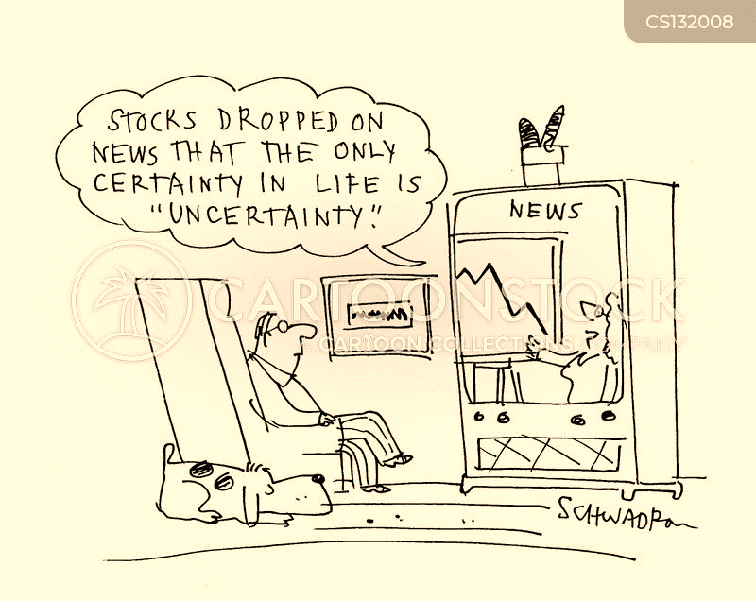
Reasoning with Uncertainty
AIFA (AI61005) 2022 Autumn
Plaban Kumar Bhowmick

Slide 2
Introduction

Slide 3
Agent in Uncertain World
World view till now
Completely observable
Deterministic outcomes
Complete state information
Uncertainty in world view
Partially observable
Outcomes are non-deterministic
Incomplete state information

Slide 4
Agent in Uncertain World: Example
Robot with smell sensor does not have the exact location of an object
Doctor diagnoses based on observation of patients
A teacher does not know exactly what or whether a student understands
Exact causes of malfunction of a machine
A bomb detector runs multiple probes

Slide 5
Agent in face of Uncertainty
Has certain belief about the state of the partially observable world
Has to reason with uncertain knowledge/belief
Live with uncertain outcome
Representing uncertainty
Probability: Calculus of gambling

Slide 6
Certain vs. Uncertain World
CSP – States and Variables
Constraints eliminate some worlds.
Other worlds are possible
Probabilistic – States and Variables
Does not eliminate any world
Some worlds are more likely; others are less
T | W | CSP | P
hot | sun | T | 0.4
hot | rain | F | 0.1
cold | sun | F | 0.2
cold | rain | T | 0.3

Slide 7
Probability Basics

Slide 8
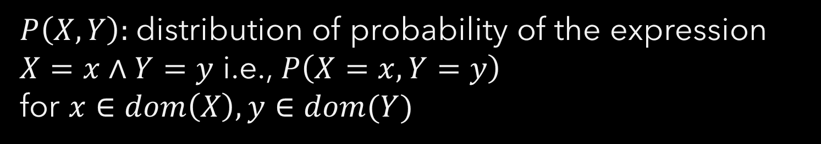
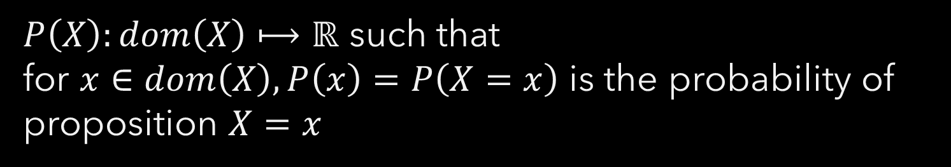
Probabilistic Knowledge Base
Proposition are represented via Random Variables ($T=hot$)
Probability Distribution ($P(X)$):
$P\left(X\right):dom\left(X\right)⟼ℝ$ such that
for $x∈dom\left(X\right), P\left(x\right)=P\left(X=x\right)$ is the probability of proposition $X=x$
Joint Probability Distribution ($P(X,Y)$):
$P\left(X,Y\right):$distribution of probability of the expression $X=x∧Y=y$ i.e., $P\left(X=x,Y=y\right)$
for $x∈dom\left(X\right), y∈dom(Y)$

Slide 9



Probabilistic Knowledge Base: Axioms
Axiom 1: $0≤P(α)$ for any proposition $α$
Axiom 2: $P\left(τ\right)=1$ if $τ$ is a tautology
Axiom 3: If $α$ and $β$ are mutually exclusive [$¬(α∧β)$ is a tautology]
$P\left(α∨β\right)=P\left(α\right)+P(β)$
$P\left(¬α\right)=1−P\left(α\right)$
$$∀_{α} P\left(α\right)=\sum_{d∈dom(V)}{P\left(α∧V=d\right)}$$
If $α⟺β, P\left(α\right)=P\left(β\right)$
$$P\left(α\right)=P\left(α∧β\right)+P(α∧¬β)$$
$$P\left(α∨β\right)=P\left(α\right)+P\left(β\right)+P(α∧β)$$

Slide 10
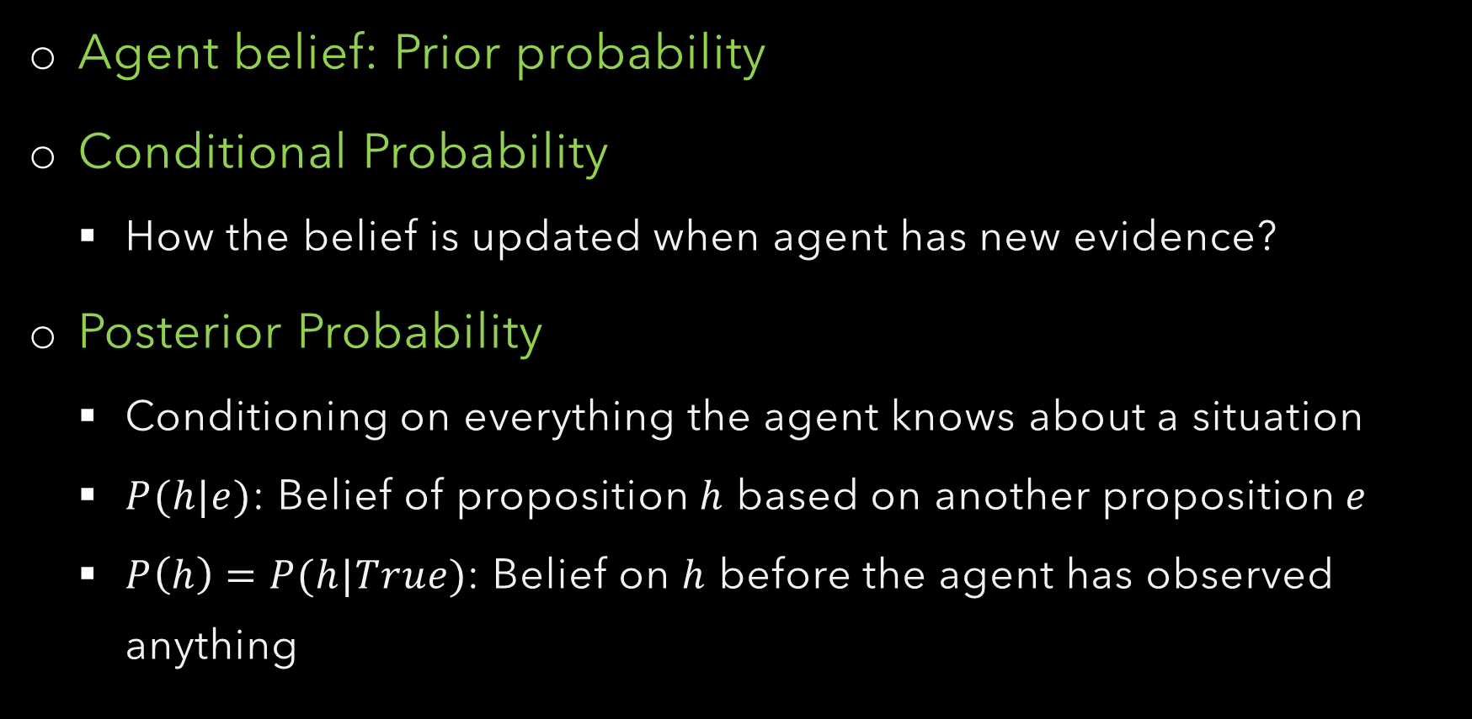
Conditional Probability
Agent belief: Prior probability
Conditional Probability
How the belief is updated when agent has new evidence?
Posterior Probability
Conditioning on everything the agent knows about a situation
$P(h|e)$: Belief of proposition $h$ based on another proposition $e$
$P\left(h\right)=P(h|True)$: Belief on $h$ before the agent has observed anything

Slide 11
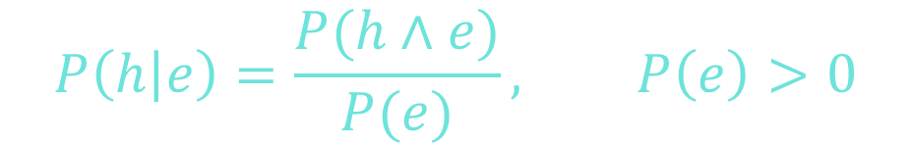
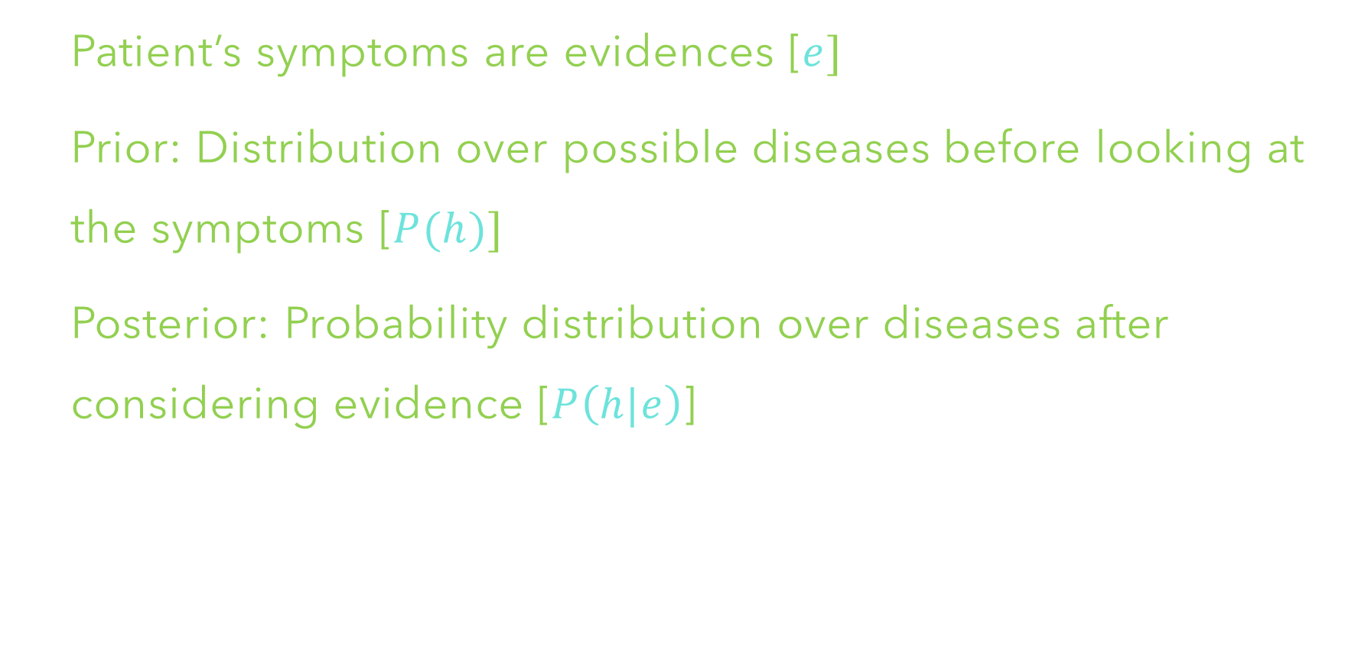
Conditional Probability: Diagnostic Assistant
Patient’s symptoms are evidences [$e]$
Prior: Distribution over possible diseases before looking at the symptoms [$P(h)]$
Posterior: Probability distribution over diseases after considering evidence [$P\left(h|e\right)$]
$$P\left(h | e\right)=\frac{P(h∧e)}{P(e)}, P\left(e\right)>0$$

Slide 12
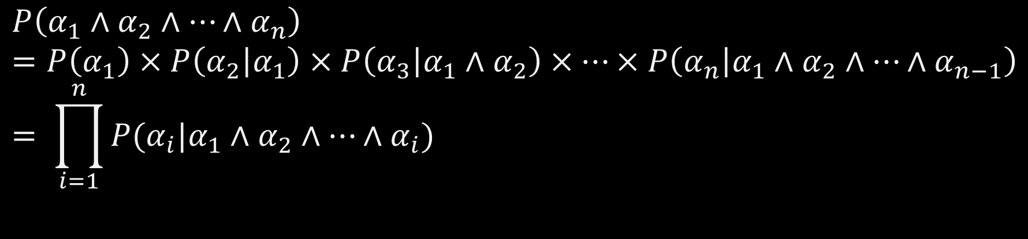


Joint Probability
Chain Rule: Decompose Conjunctions
$$P\left(α_{1}∧α_{2}∧…∧α_{n}\right)=P\left(α_{1}\right)×P\left(α_{2} | α_{1}\right)×P\left(α_{3} | α_{1}∧α_{2}\right)×…×P\left(α_{n} | α_{1}∧α_{2}∧…∧α_{n−1}\right)= \prod_{i=1}^{n}{P(α_{i}|α_{1}∧α_{2}∧…∧α_{i})}$$
Event: Set $E$ of outcomes
$$P\left(E\right)=\sum_{\left(α_{1},α_{2},…,α_{n}\right)∈E}{P\left(α_{1}∧α_{2}∧…∧α_{n}\right)}$$

Slide 13



Joint Probability: Event
T | W | P
hot | sun | 0.4
hot | rain | 0.1
cold | sun | 0.2
cold | rain | 0.3
Event: Set $E$ of outcomes
$P\left(hot∧sun\right)=0.4$
$P\left(hot\right)=0.4+0.1=0.5$
$P\left(hot∨sun\right)=0.4+0.1+0.2=0.7$

Slide 14


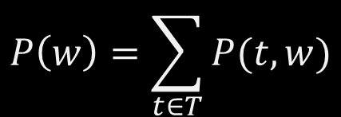
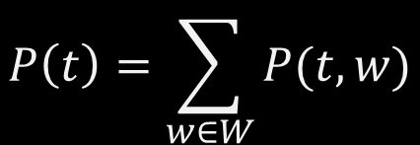
Joint Probability: Marginal Distribution
Marginalization: Combine collapsed rows by adding
$$P\left(t\right)=\sum_{w∈W}{P(t,w)}$$
T | P
hot | 0.5
cold | 0.5
T | W | P
hot | sun | 0.4
hot | rain | 0.1
cold | sun | 0.2
cold | rain | 0.3
$$P\left(T\right)$$
$$P\left(w\right)=\sum_{t∈T}{P(t,w)}$$
W | P
sun | 0.6
cold | 0.4
$$P\left(W\right)$$

Slide 15

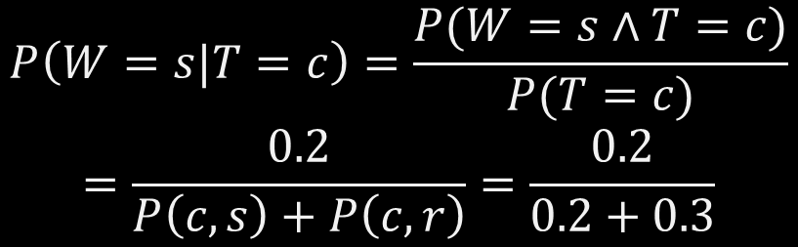
Joint to Conditional Distribution
T | W | P
hot | sun | 0.4
hot | rain | 0.1
cold | sun | 0.2
cold | rain | 0.3
$$P\left(W=s|T=c\right)=\frac{P(W=s∧T=c)}{P(T=c)}$$
$$=\frac{0.2}{P\left(c,s\right)+P\left(c,r\right)}=\frac{0.2}{0.2+0.3}$$
$$P\left(W=r|T=c\right)=\frac{0.3}{0.2+0.3}$$

Slide 16

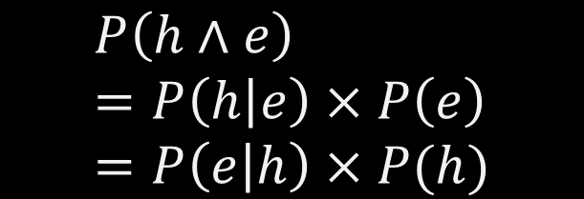
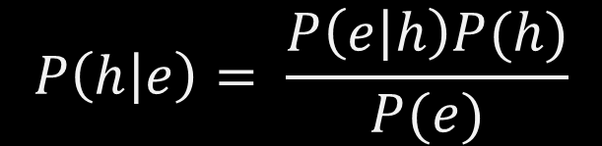
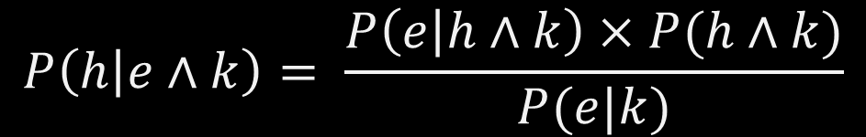
Bayes’ Rule
How should an agent update its belief in a proposition based on a new piece of evidence?
$P\left(h | k\right)−→$ Belief in proposition $h$based on knowledge $k$
$P\left(h | e∧k\right)−→$ New belief in proposition $h$based on new evidence $e$
$$P\left(h∧e\right)=P\left(h | e\right)×P\left(e\right)=P\left(e | h\right)×P(h)$$
$$P\left(h | e∧k\right)= \frac{P\left(e | h∧k\right)×P(h∧k)}{P(e|k)}$$
$$P\left(h | e\right)= \frac{P\left(e | h\right)P(h)}{P(e)}$$

Slide 17


Independence
Number of assignments to specify joint prob. distribution
$$P\left(α_{1}∧α_{2}∧…∧α_{n}\right)⇒O(2^{n})$$
Assume some events to be independent
$$X⊥Y : ∀_{x,y} P\left(X=x,Y=y\right)=P\left(X=x\right)P(Y=y)$$
$$∀_{x,y} P\left(x|y\right)=P\left(x\right)$$

Slide 18
Independence
Independence is a simplifying modelling assumption
{2020_US_Presidential_Election_Result, your_toothache}
{weather, traffic, cavity, toothache}
Test of Independence:
T | P
hot | 0.5
cold | 0.5
T | W | P
hot | sun | 0.4
hot | rain | 0.1
cold | sun | 0.2
cold | rain | 0.3
T | W | P
hot | sun
hot | rain
cold | sun
cold | rain
W | P
sun | 0.6
cold | 0.4

Slide 19




Independence
N fair independent coin flips
$$P\left(X_{1}\right)$$
$$P\left(X_{2}\right)$$
$$P\left(X_{n}\right)$$
H | 0.5
T | 0.5
H | 0.5
T | 0.5
H | 0.5
T | 0.5
$$X_{1}$$ | $$X_{2}$$ | $$………$$ | $$X_{n}$$ | $$P$$

Slide 20





Conditional Independence
Two events $A$ and $B$ are conditionally independent given another event $C$with $P\left(C\right)>0$:
$$P\left(A∧B|C\right)=P\left(A | C\right)P(B|C)$$
$$P\left(A | B\right)=\frac{P(A∧B)}{P(B)}$$
$$P\left(A | B,C\right)=\frac{P(A∧B|C)}{P(B|C)}=\frac{P\left(A | C\right)×P(B|C)}{P(B|C)}$$
$$=P(A|C)$$

Slide 21

Conditional Independence
$$P\left(Toothache, Cavity, Catch\right)$$
$$P\left(+catch|+toothache, +cavity\right)=P\left(+catch|+cavity\right)$$
$$P\left(+catch|+toothache, −cavity\right)=P\left(+catch|−cavity\right)$$
$$P\left(Catch|Toothache, Cavity\right)=P\left(Catch|Cavity\right)$$
$$P\left(Toothache|Catch, Cavity\right)=P\left(Toothache|Cavity\right)$$
$P\left(Toothache,Catch|Cavity\right)=P\left(Toothache|Cavity\right)$ $P\left(Catch|Cavity\right)$
$$Toothache⊥Catch | Cavity$$

Slide 22

Conditional Independence
Amount of speeding fine (SF), Type of Car (CT), Speed (S)
Lung Cancer (LC), Yellow Teeth (YT), Smoking (S)
Car Motor working? (M), Radio working (R), Battery State (B)
Future (F), Past (P), Present (C)
Imagine that you know the value of Z and you are trying to guess the value of X. In your pocket is an envelope containing the value of Y. Would opening the envelope help you guess X. If not $X⊥Y|Z$

Slide 23
Bayesian Networks

Slide 24



Conditional Independence & Chain Rule
Interested in: $P(X_{1}, X_{2}, ……, X_{n})$
$O(2^{n})$ assignments
Chain Rule:$P\left(X_{1}, X_{2}, ……, X_{n}\right)=P\left(X_{1}\right)P\left(X_{2} | X_{1}\right)……P(X_{n}|X_{1}, X_{2}, ……X_{n−1})$
Still $O(2^{n})$ assignments
Make Conditional Independence Assumption : $P\left(X_{i} | X_{j}, X_{k}\right)=P\left(X_{i} | X_{j}\right)$
Markov Assumption:$P\left(X_{1}, X_{2}, ……, X_{n}\right)=P\left(X_{1}\right)P\left(X_{2} | X_{1}\right)……P(X_{n}|X_{n−1})$

Slide 25





Conditional Independence & Chain Rule
$$P\left(Rain, Traffic, Umbrella\right)$$
$$T⊥U|R$$
$$P\left(U | T,R\right)=P(U|R)$$
$$P\left(T | U,R\right)=P(T|R)$$
$$P\left(T,U | R\right)=P\left(T | R\right)P(U|R)$$
$$P\left(Rain,Traffic, Umbrella\right)=P\left(Rain\right)P\left(Traffic | Rain\right)P(Umbrella|Traffic,Rain)$$
$$=P\left(Rain\right)P\left(Traffic | Rain\right)P(Umbrella|Rain)$$

Slide 26

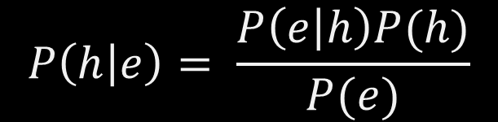

Bayes’ Rule: Revisited
$$P\left(h | e\right)= \frac{P\left(e | h\right)P(h)}{P(e)}$$
Modelling Causality with Bayes’ Rule
$$P\left(Cause | Effect\right)= \frac{P\left(Effect | Cause\right)P(Cause)}{P(Effect)}$$
Diagnostic probability
$$P\left(fire | alarm\right)= \frac{P\left(alarm | fire\right)P(fire)}{P(alarm)}$$

Slide 27
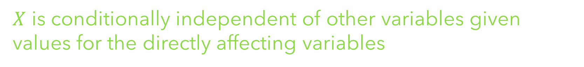





Bayesian Networks
Given a random variable $X$, a small set of variables may directly affect $X$’s value
$X$ is conditionally independent of other variables given values for the directly affecting variables
$$X_{j}$$
$$X_{k}$$
$$X_{m}$$
$$X_{i}$$
Bayesian Network is a graphical representation of conditional dependence among a set of random variables

Slide 28


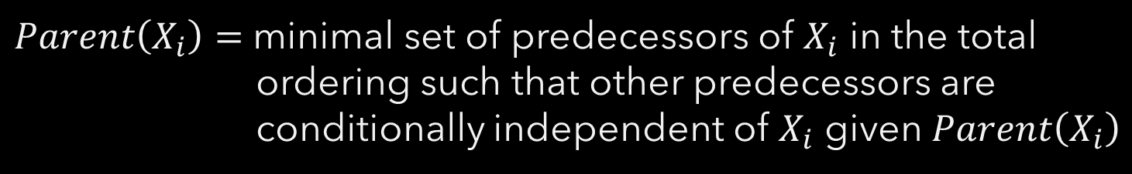

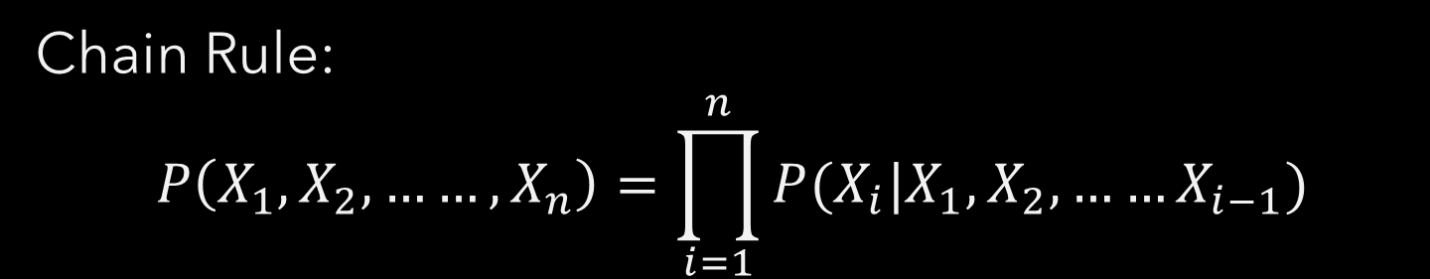



Bayesian Networks
$$X_{j}$$
$$X_{k}$$
$$X_{m}$$
Chain Rule:
$$P\left(X_{1}, X_{2}, ……, X_{n}\right)=\prod_{i=1}^{n}{P(X_{i}|X_{1}, X_{2}, ……X_{i−1})}$$
$$X_{i}$$
$Parent\left(X_{i}\right)=$ minimal set of predecessors of $X_{i}$ in the total
ordering such that other predecessors are
conditionally independent of $X_{i}$ given $Parent\left(X_{i}\right)$
$$Parent\left(X_{i}\right)⊆\{X_{1}, X_{2}, ……, X_{i−1}\}$$
$$P\left(X_{i} | X_{1}, X_{2}, ……X_{i−1}\right)=P(X_{i}|Parent\left(X_{i}\right))$$
$$P\left(X_{1}, X_{2}, ……, X_{n}\right)=\prod_{i=1}^{n}{P(X_{i}|{Parent(X}_{i}))}$$
factors of JPD

Slide 29
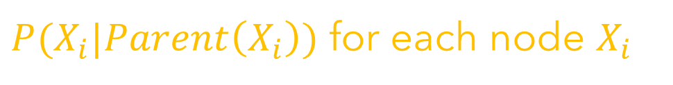
Bayesian Networks
Bayesian Belief Networks: Representation
A Directed Acyclic Graph (DAG)
Each node is labeled by a random variables
A domain of each random variable
A set of CPDs associated each the nodes
$P(X_{i}|Parent\left(X_{i}\right))$ for each node $X_{i}$

Slide 30
Bayesian Networks: Example
Fire Diagnostic Assistant
Whether there is fire in building based on noisy sensor info
Agent Information
Report: whether everyone is leaving the building
False Positive: Report people leaving falsely
False Negative: Does not report when everyone is leaving
Fire Alarm
People may leave when it goes off
Tampering or fire could affect the alarm
Smoke: Fire can cause smoke to rise

Slide 31
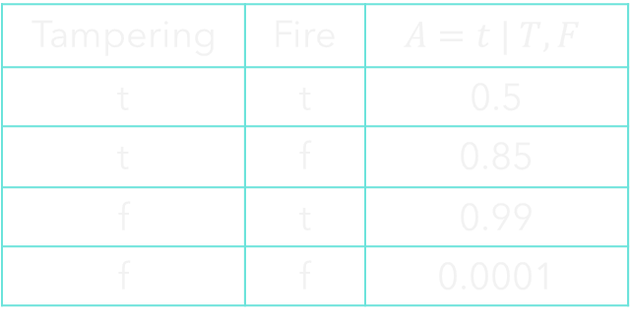
Bayesian Networks: Example
Tampering=t
0.02
Fire (F)
Fire=t
0.01
Tampering (T)
Tampering | Fire | $$A=t | T,F$$
t | t | 0.5
t | f | 0.85
f | t | 0.99
f | f | 0.0001
Fire | S=t | F
t | 0.9
f | 0.01
Alarm (A)
Smoke (S)
Alarm | L=t | A
t | 0.88
f | 0.001
Leaving (L)
Leaving | R=t | L
t | 0.75
f | 0.01
Report (R)
Number of Assignments:

Slide 32

Bayesian Networks: Example
$$P(Tampering=t, Fire=f, Alarm=t, Smoke=f, Leaving=t, Report=t)=$$
$$P(Smoke=t)=$$

Slide 33


Bayesian Networks: Example
$$P(Alarm=t)=$$
$$P(Leaving)=$$

Slide 34

Bayesian Networks: Example
$$P(Report=t)=$$

Slide 35
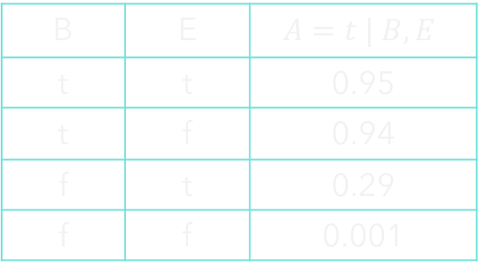
Bayesian Networks: Example
Burglary=t
0.001
Earthquake (E)
Earthquake=t
0.002
Burglary (B)
B | E | $$A=t | B,E$$
t | t | 0.95
t | f | 0.94
f | t | 0.29
f | f | 0.001
Alarm (A)
A | J=t | A
t | 0.90
f | 0.05
JohnCalls (L)
MarryCalls (R)
A | M=t | A
t | 0.70
f | 0.01

Slide 36
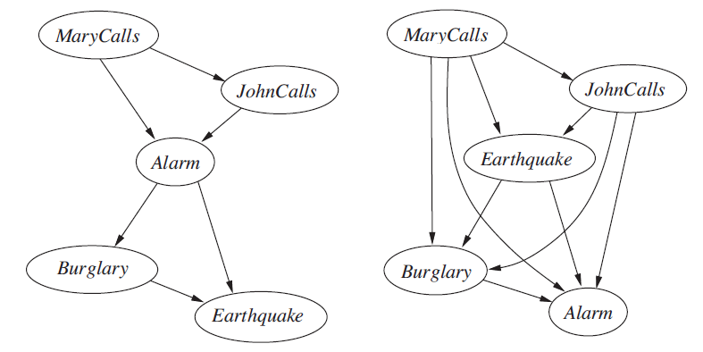
Bayesian Networks: Construction Issues

Slide 37







Bayesian Networks: CI and BN Topology
$$X$$
$$Y$$
$$Z$$
$$W$$
$P(X,Y,Z,W)=P\left(X\right)P(Y|X)$ $P(Z|X,Y)$ $P(W|X,Y,Z)$
$P(X,Y,Z,W)=P\left(X\right)P(Y|X)$ $P(Z|Y)$ $P(W|Z)$
$$X$$
$$Y$$
$$Z$$
Are X and Z truly independent?
Low pressure causes rain, rain causes traffic
D-separation to study independence properties

Slide 38





D-Separation: Causal Chains
L = Low Pressure
R = Rain
$$L$$
$$R$$
$$T$$
T = Traffic
$P(l,r,t)=P\left(l\right)P(r|l)$ $P(t|r)$
Whether L and T are independent? NO
Whether L and T are independent given R?
$$P\left(t | l,r\right)=\frac{P\left(l,r,t\right)}{P\left(l,r\right)}=\frac{P\left(l\right)P\left(r | l\right)P(t|r)}{P\left(l\right)P(r|l)}=P(t|r)$$
Evidence along the chain blocks influence or information flow

Slide 39


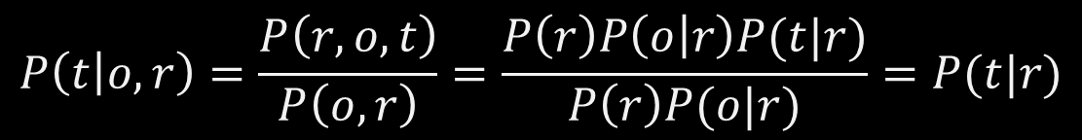


Common Cause
$$R$$
Whether O and T are independent? NO
$$O$$
$$T$$
Whether O and T are independent given R?
$P(r,o,t)=P\left(r\right)P(o|r)$ $P(t|r)$
$$P\left(t | o,r\right)=\frac{P\left(r,o,t\right)}{P\left(o,r\right)}=\frac{P\left(r\right)P\left(o | r\right)P(t|r)}{P\left(r\right)P(o|r)}=P(t|r)$$
O = Lawn Overflow
R = Rain
T = Traffic
Observing the cause blocks influence between effects

Slide 40



Common Effect (V-Structure)
$$R$$
$$M$$
Whether R and M are independent? YES
$$T$$
Whether R and M are independent given T? NO
$P(r,o,t)=P\left(r\right)P(o|r)$ $P(t|r)$
Traffic is a effect of two competing explanations
M = EPL Match
R = Rain
T = Traffic
Observing an effect activates influence between causes

Slide 41






D-Separation
$$L$$
When two nodes are connected via an undirected path; the path breaks in presence of an evidence node
$$R$$
$$M$$
$$T$$
When evidence node in a V-structure is not observed
$$O$$
$$T′$$

Slide 42
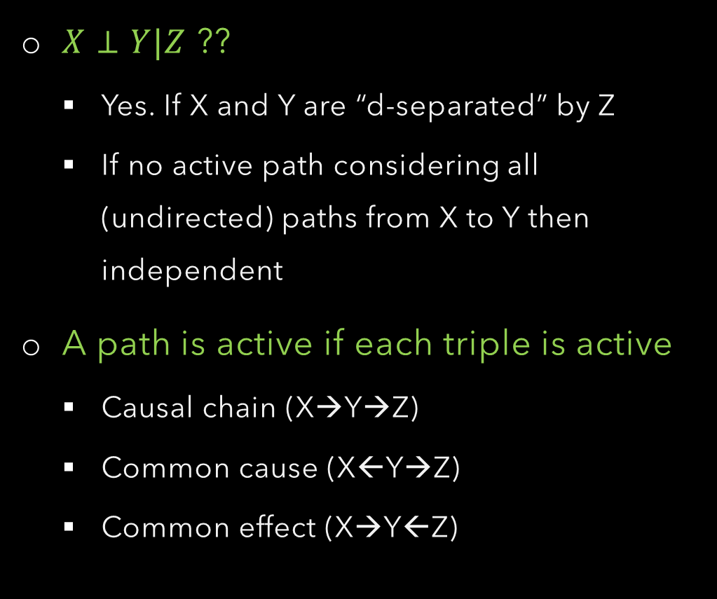
Path Patterns
Active triples
Inactive triples
$X⊥Y|Z$ ??
Yes. If X and Y are “d-separated” by Z
If no active path considering all (undirected) paths from X to Y then independent
A path is active if each triple is active
Causal chain (X→Y→Z)
Common cause (X←Y→Z)
Common effect (X→Y←Z)

Slide 43







Path Pattern & CI: Examples
$R⊥M$
$$R$$
$$M$$
$R⊥M|T$
$$T$$
$R⊥M|T′$
$$T′$$

Slide 44











Path Pattern & CI: Examples
$$L$$
$L⊥T^{′}|T$
$L⊥M$
$$R$$
$$M$$
$L⊥M|T$
$$O$$
$$T$$
$L⊥M|T′$
$L⊥M|T,R$
$$T′$$

Slide 45







Path Pattern & CI: Examples
$$R$$
$T⊥O$
$$O$$
$$T$$
$T⊥O|R$
$$H$$
$T⊥O|R,H$
O = Lawn Overflow
R = Rain
T = Traffic
H = Stuck at home

Slide 46



















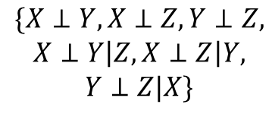













Topology & Distribution
$$\{X⊥Y,X⊥Z,Y⊥Z,$$
$$X⊥Y\left|Z,X⊥Z\right|Y,$$
$$Y⊥Z|X\}$$
$$Y$$
$$X$$
$$Z$$
$$\{\}$$
$$Y$$
$$Y$$
$$\{X⊥Z|Y\}$$
$$X$$
$$Z$$
$$X$$
$$Z$$
$$Y$$
$$Y$$
$$Y$$
$$X$$
$$Z$$
$$X$$
$$Z$$
$$X$$
$$Z$$
$$Y$$
$$Y$$
$$Y$$
$$X$$
$$Z$$
$$Y$$
$$X$$
$$Z$$
$$X$$
$$Z$$
$$X$$
$$Z$$

Slide 47
Summary
Modelling uncertainty and belief with probability
Using conditional independence to factorize joint probability in an efficient way.
Bayesian Network is a graphical model of a set of conditional independences
Exact inference in BN with variable elimination
Approximate inference algorithms (Monte Carlo, Gibbs Sampling, etc.)
Probabilistic reasoning with time (Hidden Markov Models, Dynamic BN)

